Slide 1
Modeling Selectivity in Stock Synthesis

Slide 2
Notes on selectivity in SS
Parametric and Non-Parametric options
Semi-Parametric option under development
Selectivity can be a function of either age or length or a combination of both
Parameters of the selectivity curves have all the functionality as other parameters:
time blocks, random variation, covariates, priors, etc.

Slide 3
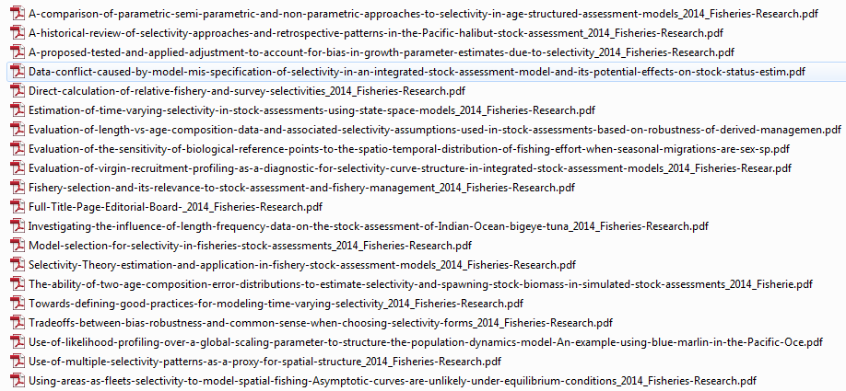
CAPAM Workshop - 2013

Slide 4
Functional forms
Full selectivity for all ages/lengths
typically used for age with length is also used and vice versa
Logistic
commonly used for asymptotic selectivity
Double logistic
Double normal
most commonly used selectivity, allows a declining right limb
Exponential-logistic
Piecewise linear (in log space) function of length
One value per age
Random walk across ages
Selex override: spawning biomass, recruitment, or rec dev
Mirror selectivity of another fleet/survey
others....

Slide 5
Double normal
Comprised of the outer sides of two adjacent normal curves with separate variance parameters and peaks joined by a horizontal line.
The parameters include
the selectivity at the smallest and largest ages/sizes,
the age/size where the selectivity first reaches full selectivity,
the length of the plateau, and
two parameters controlling the slope of the ascending and descending limbs.
Can be made asymptotic by fixing some parameters
Options for parameters representing selectivity at smallest and largest ages/sizes:
use, ignore, or ignore and make selectivity constant below/above specified bin

Slide 6
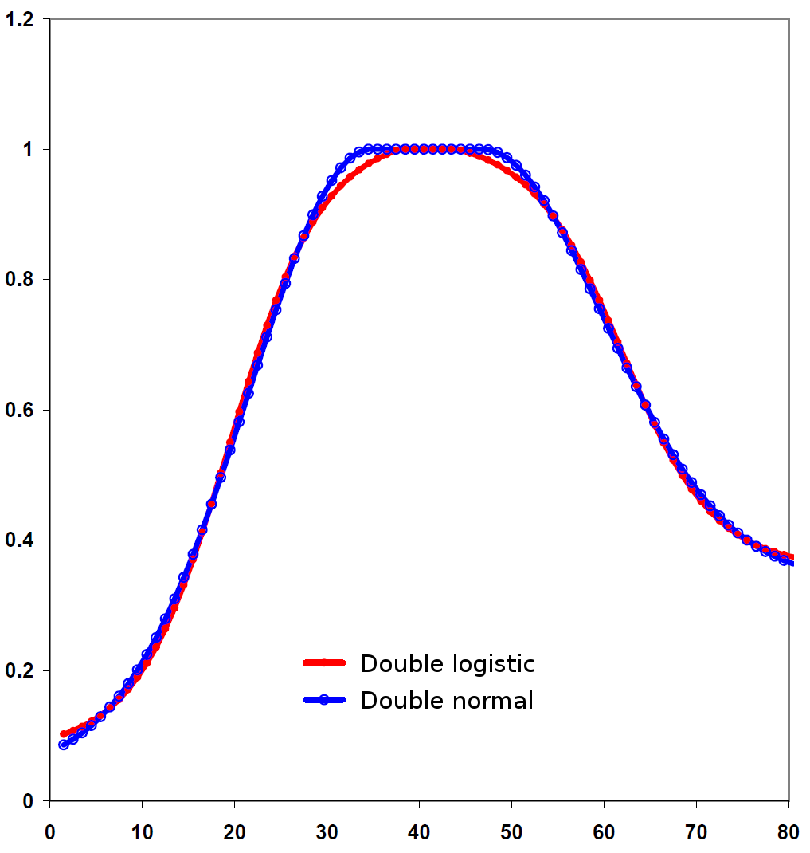
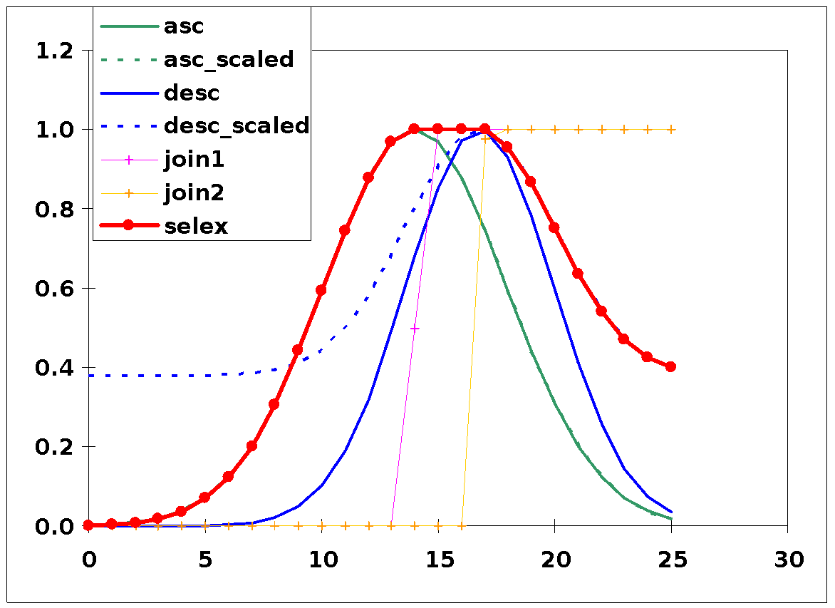
Double normal
Can be similar to double logistic
Simpler, better behaved function

Slide 7
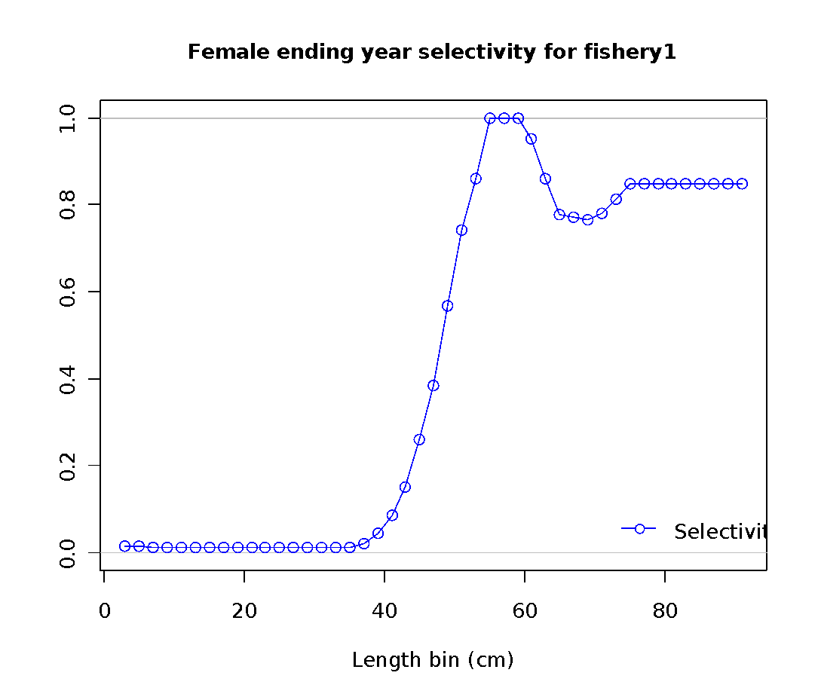
Piecewise linear selectivity

Slide 8
Piecewise - Update
Size selectivity #6
Upper and lower range are entered as lengths, not bin number
Calculated selectivity is:
exp(interpolated value_{L} – max(I.V.))

Slide 9
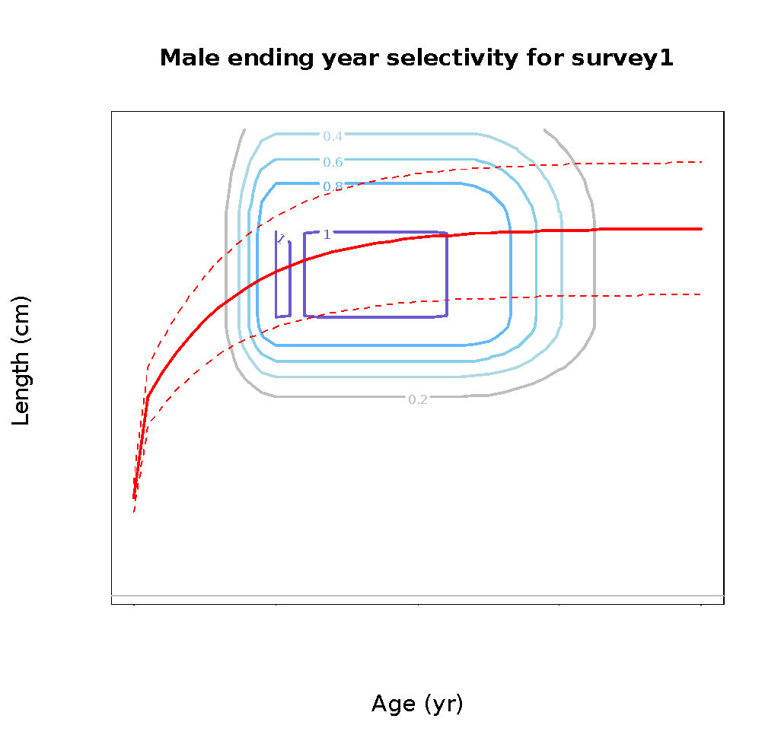
Combining selectivity at length at age
Independent functions
Example with two double normals:
growth curve

Slide 10
Male offset
Male (or female) selectivity is modeled two ways
1. Offset from female selectivity using a broken stick with parameters:
age/size at the break point
log( male / female selectivity ) at min, max, and break point
2. A function of parameters which are computed as offsets from parameters for other gender (only available for logistic and double normal)

Slide 11
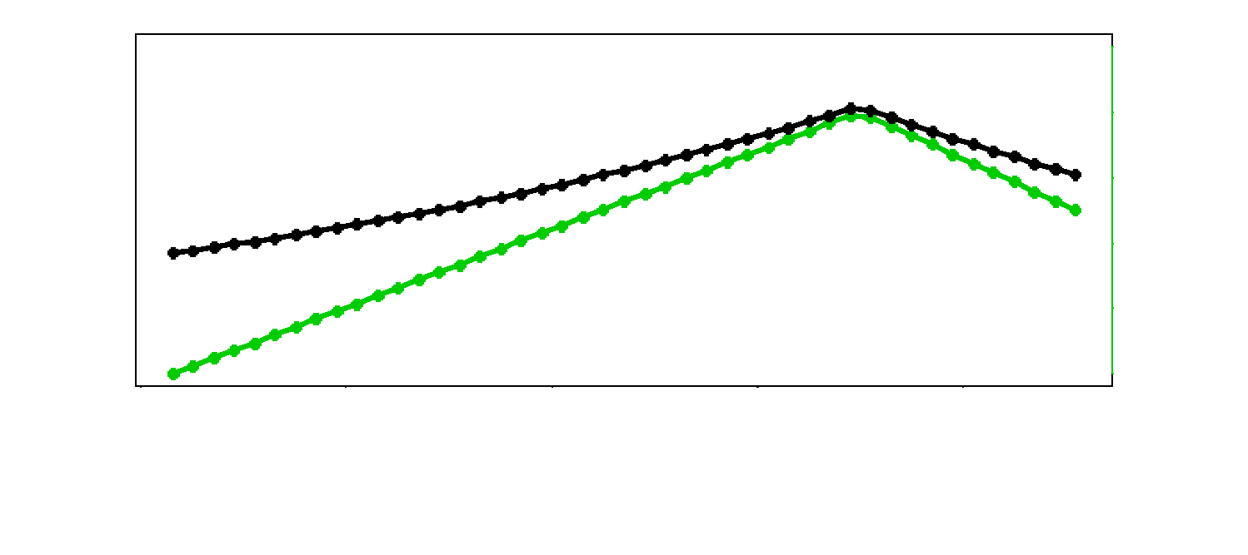
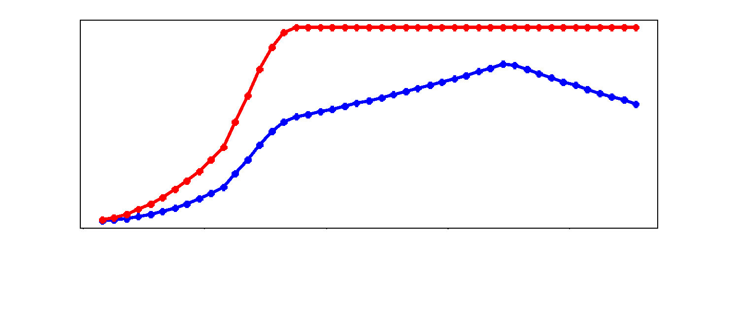
Male offset

